Slide 1
Open Access Advocacy:
Empowering Sustainable and Equitable Knowledge Sharing
Xu Jiayi
Managing Editor, CAAI Transactions on Intelligence Technology
Chongqing University of Technology, China
Council Member, Committee on Publication Ethics (COPE)
Editor, Directory of Open Access Journals (DOAJ)

Slide 2
Table of Contents
Introduction to Open Access
Current Landscape of Open Access in China
Challenges to Open Access

Slide 3
Introduction to Open Access
Gold Open Access
This is one of the most open, least restrictive types of open access. The final published version of research articles is permanently and freely available for anyone, anywhere.
Green Open Access
This is when the accepted article is first deposited into a subject-based repository or an institution’s repository, which then often specifies how the article may be used.
Diamond Open Access
This refers to journals that provide free access for readers, but also for research authors to publish in. Although the name is slightly deceiving, diamond open access journals are supported by institutions or other infrastructures, hence they may not have a high-impact factor.

Slide 4
Introduction to Open Access
Hybrid Open Access
This is one of those types of open access where a subscription journal offers open access, where the processing fee is paid for individual articles. Although the processing fees may be higher than that of a regular open access journal, it may be worth the effort if your article fits the journal’s aims and scope perfectly.
Bronze Open Access
This is not fully open access because although the article will be freely available, the types of open access journals that offer this kind of service have no open license.
Black Open Access
This is an illegal open access model, where although the article is not openly licensed, it is still shared by illicit services that offer free access to scientific publications or other content (e.g., Sci-Hub).

Slide 5
Introduction to Open Access
What is Open Access?
This is an open access journal which means that all content is freely available without charge to the user or his/her institution. Users are allowed to read, download, copy, distribute, print, search, or link to the full texts of the articles, or use them for any other lawful purpose, without asking prior permission from the publisher or the author.
+
NEED USER LICENSE NEED COPYRIGHT STATEMENT
Preferably Creative Commons copyright for author or for publisher

Slide 6
Current Landscape of Open Access in China
Policies and Guidelines – Governmental Level
2002,2004
Two national documents require that scientific knowledge generated by public funding and scientific infrastructure built with financial funds be open and shared
2014
Chinese Premier Li Keqiang clearly expresses support for establishing an open access mechanism for scientific knowledge funded by public finance
2012
The State Council issues a policy document strengthening the openness and sharing of science and technology resources
2018
The State Council issues the "Measures for the Management of Scientific Data": scientific data formed with government funding to be open and shared

Slide 7
Current Landscape of Open Access in China
Policies and Guidelines – Governmental Level
2019
“Suggestions on Deepening Reform and Cultivating World-class STM Journals” emphasizes the need to expand and deepen international cooperation
2022
The "Initiative on International Cooperation in Scientific Research Behavior” directs Chinese researchers to adopt global open science and technology cooperation approaches
2023
XI Jinping: China will continue to promote international scientific and technological cooperation with more open thinking and measures, build an open and innovative ecosystem with global partners, and work together to create an open, fair, just, and non-discriminatory environment for scientific and technological development
2021
“Open science" officially appears in "Science and Technology Progress Law of the People's Republic of China“

Slide 8
Current Landscape of Open Access in China
Policies and Guidelines – Institutional Level
2004
2015
2020
2022
NSFC and CAS sign the Berlin Declaration on Open Access to Knowledge in the Science and Humanities
NSFC issues the Implementation Rules of Open Access Policy for Basic Research Repository
19 organizations in China had sign the Open Access 2020 Initiative
the Open Science Promotion Consortium is established
China's open sharing policy is ushered in by the statements of CAS and NSFC on Open Access to Papers Published by Publicly Funded Research Projects
Chinese Academy of Agricultural Sciences :"Statement of Implementing an Open Access Policy for Papers Published in Public Funded Research Projects" "Measures for Agricultural Science Data Management and Open Sharing "
Tsinghua University launches the "Open Science Support Program" with the aim of accelerating the widespread dissemination of scientific knowledge created by universities and research institutes
2014
2019
2021

Slide 9
Current Landscape of Open Access in China
Open Access Papers
Number of papers from China:
159640 (2011)
630906 (2021)
( Average annual growth rate 14.7%)
Number of OA papers:
25235 (2011)
238771 (2021 )
( Average annual growth rate 25.2%)
Gold OA papers:
14454 (2011, 57.3%)
206375(2021, 86.4%)
(Average annual growth rate 30.5%)
Articles published in international journals and open access articles of China, 2011-2021. Source: Open Access Publishing in China 2022
Database: Clarivate’s Science Citation Index; Literature types: Article and Review; Registered address of the paper includes China

Slide 10
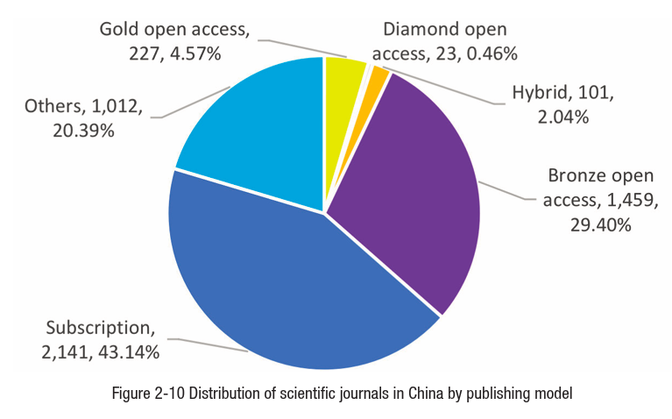
Current Landscape of Open Access in China
Journal Publishing Models
Results:
36.47% of them were involved in open access (29.40% of which were Bronze). English-language journals in China are increasingly choosing open access and becoming more standardized. Most Chinese-language journals are not standardized in terms of OA policies, licenses, and so on .
Among 428 English language journals, 271 are fully open access (63.3%)，122 hybrid（28.5%），35 subscription（8.2%）. 82% of English language journals in China are co-published with international publishers, with the vast majority being open access.
In 2022, 4963 scientific journals in China were analyzed.

Slide 11
Current Landscape of Open Access in China
China’s Transformative Agreements
Start date | Chinese institutions | International publishing organizations | Models
2020 2021 | National Science Library, CAS (NSLC) | Oxford University Press Association for Computing Machinery | Read and Publish ACM Open
2021 | Chinese Academy of Medical Sciences | Karger Press | APC Credit
2021 | Shanghai Jiao Tong University | Cambridge University Press | Read & Publish
2021 2022 2022 | Tsinghua University | Association for Computing Machinery Cambridge University Press International Water Association (IWA) | ACM Open Read and Publish Subscribe to Open (Ended)
2022 | Institute of Microbiology, CAS | Microbiology Society | Publish and Read
2022 | Xi'an Jiaotong-Liverpool University | Cambridge University Press | Read & Publish
2022 2023 | Wuhan university | IWA Microbiology Society | Read & Publish Publish & Read
2023 | Chinese Academy of Agricultural Sciences | Microbiology Society | Publish and Read
2023 | Chang’an University | IWA | Read & Publish
2023 | Shenzhen Pengcheng Laboratory | Association for Computing Machinery | ACM Open
2023 | Westlake University | Association for Computing Machinery | ACM Open
2023 2024 | Fudan University | Cambridge University Press Microbiology Society | Read & Publish Publish and Read
By September 2023, there are 17 TAs signed by 12 Chinese institutions, involving 7 international publishing institutions, covering various transformative models.

Slide 12
Current Landscape of Open Access in China
Attitudes Towards Open Access by Researchers in China
Knowledge of open access among researchers in China
The acceptable range of APCs among researchers in China
No knowledge,
9.11%
A very good
understanding,
16.23%
5000 RMB-
700USD
5000~10000 RMB
700-1400USD
Know a little,
32.24%
Moderate
understanding,
42.42%
10000~15000 RMB
1400-2100USD
15000~20000 RMB
2100-2800USD
20000 RMB+
Figure 2-7 Knowledge of open access among researchers in China
2800USD+
Source: Open Access Publishing in China 2022

Slide 13
Challenges to Open Access
Predatory Publishers & Journals
“Predatory publishers,” which Beall described as organizations that “publish counterfeit journals to exploit the open-access model in which the author pays. These predatory publishers are dishonest and lack transparency. They aim to dupe researchers, especially those inexperienced in scholarly communication.”
——Beall, a librarian at the University of Colorado in Denver

Slide 14
Challenges to Open Access
Common Characteristics of Journals
Claims to be a peer-reviewed open-access publication but does not provide adequate peer review or the level of peer review promised (some predatory journals repeatedly use a template as their peer review report).
Advertises a Journal Impact Factor or other citation metric on the website that is incorrect or cannot be verified.
May advertise an unrealistic time line for publication.
Publishes all articles for which authors pay an APC even if the article is low quality, unrelated to the topic of the journal, or nonsensical.
Publishes articles that have many grammar mistakes (little or no copyediting).
Editorial board includes people who do not exist, do not have credentials relevant to the topic of the journal, have affiliations that cannot be verified, or are real people who are not aware that they are listed as members.
Mimics name or website of other well-known, legitimate journals.
Source: Elmore, S. A., & Weston, E. H. (2020). Predatory journals: what they are and how to avoid them. Toxicologic pathology, 48(4), 607-610.

Slide 15
Challenges to Open Access
Common Characteristics of Journals
Aggressively targets potential authors through e-mails.
May state that offices are in one country but contact details are in another.
Solicitation e-mails contain grammatical errors of phishing scams.
Lack of transparency about acceptance process or APCs, so that authors do not know how much they will be charged until their article is accepted.
Requires authors sign away their copyright to the article at the time of submission, making it impossible for the author to submit the article to another publisher.
Publishes articles submitted before the authors have signed the publishing agreement, then refuses to take the article down if the author withdraws the submission.
Removes articles or entire journals from the web without warning or informing authors.
Source: Elmore, S. A., & Weston, E. H. (2020). Predatory journals: what they are and how to avoid them. Toxicologic pathology, 48(4), 607-610.

Slide 16
Challenges to Open Access
Resources That May Be Helpful for Identifying Predatory Journals
ThinkCheckSubmit.org is a nonprofit website with a step-by-step guide to evaluating journal quality. Please follow the checklist of ThinkCheckSubmit to assess whether or not a publisher is suitable for your research.
The Directory of Open Access Journals (DOAJ) is a nonprofit database containing a searchable list of high-quality, peer-reviewed open-access journals in all scholarly disciplines. Please check whether the open access journal is listed in the Directory of Open Access Journals (DOAJ).
The Committee on Publication Ethics (COPE) is a group of publishing organizations that agree to uphold certain standards ethical publishing practices. The COPE website provides a searchable database of reputable publishers and journals, guidance for authors and editors on addressing suspected misconduct, and example cases and advice for authors that have dealt with predatory publishers. Please check whether the publisher or journal is a current member of the Committee on Publication Ethics (COPE) and follow its guidelines.

Slide 17
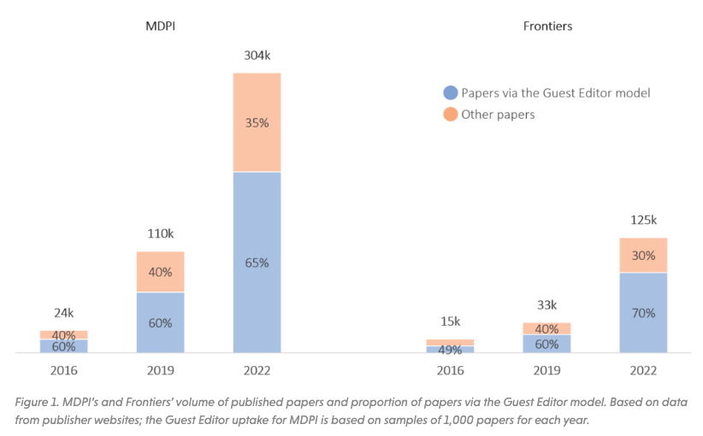
Challenges to Open Access
Special Issues and Paper Mills

Slide 18
Challenges to Open Access
Special Issues and Paper Mills
Wiley paused Hindawi special issues amid quality problems, lost $9 million in revenue
In Wiley’s third quarter that ended Jan. 31, 2023, the suspension cost Hindawi – whose business model is based on charging authors to publish – $9 million in lost revenue compared to the third quarter of 2022. The company cited the pause as the primary reason its revenue from its research segment “was down 4% as reported, or down 2% at constant currency and excluding acquisitions,” the press release stated.
So far in 2023, Hindawi has retracted over 8,000 articles . And Hindawi is not done cleaning up from paper mills’ infiltration of its special issues, according to a new report from its parent company, Wiley.
Wiley will stop using the “Hindawi” name next year. The publisher has issued a whitepaper, “Tackling publication manipulation at scale: Hindawi’s journey and lessons for academic publishing,” which explains “what happened at Hindawi” and the process the company developed to investigate and retract thousands of articles from special issues.

Slide 19
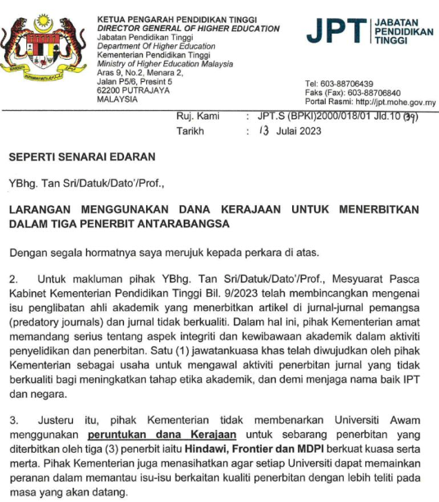
Challenges to Open Access
Special Issues and Paper Mills
MDPI’s Unremarkable Reputation
MDPI's reputation faces repeated challenges, such as the listing of 22 journals in the CAS Warning List, which resulted into an unimpressive performance for MDPI in China in 2021, and the inclusion of five journals in the newly created Level X category of the Norwegian Scientific Index in 2021.
Malaysian education ministry will no longer cover the cost of publishing in Frontiers, Hindawi, and MDPI journals.

